Slide 1
TEAM FOUNDATION SERVER (TFS)
By
Sunny
Niranjana Devi. M

Slide 2
CONTENTS
Introduction to TFS
Features of TFS
TFS Architecture
Server Login
Work Items
Test Manager
Review

Slide 3
Introduction to TFS
Team Foundation Server delivers source control, work item tracking, Team Foundation Build, a team project portal Web site, reporting, and project management capabilities. Team Foundation Server also includes a data warehouse where data from work item tracking, source control, builds, and testing tools are stored

Slide 4
Major features in Team Foundation Server
•Version control - for managing source code and other deliverables that require versioning.
•Work item tracking- for keeping track of such things as defects, requirements, tasks, and scenarios.
•Project management functions - which allow the shaping of a team project based on a user-specifiable software process, and which enable planning and tracking using Microsoft Excel and Microsoft Project.
•Team build - for enabling a common process for building executable products.
•Data collection and reporting - which aid in the assessment of a team project's state, based on information gleaned from Team Foundation Server tools.
•The Team Project Portal - which provides a central point of communication for a team project packaged as a Microsoft Windows SharePoint Services site.
•Team Foundation Shared Services - which provide a number of common infrastructure services that invisible to end users but that are important to toolsmiths and extenders.

Slide 5
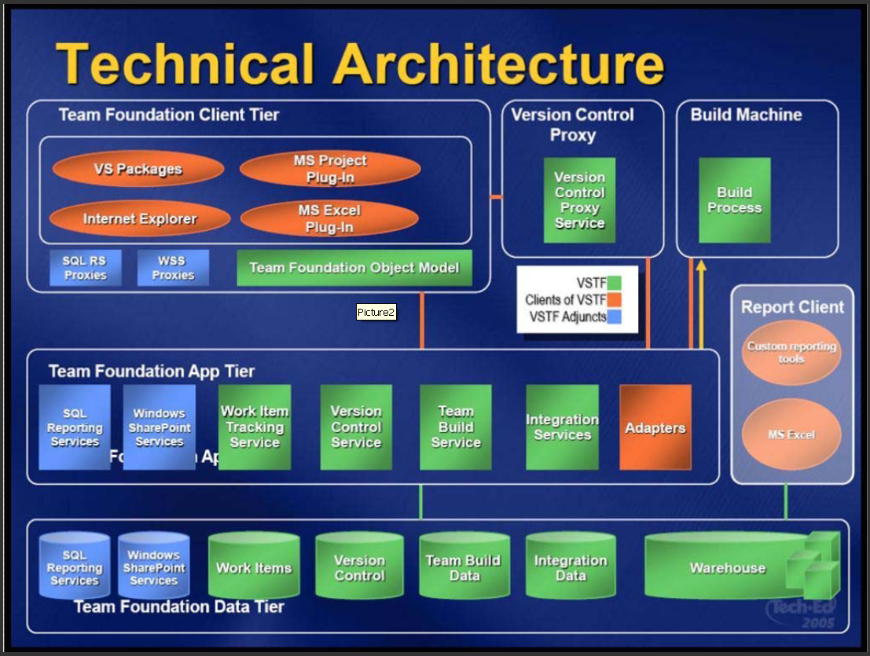
TFS Architecture

Slide 6
TFS Architecture
The client tier is used for creating and managing projects and accessing the items that are stored and managed for a project.
The Application tier exposes web services which client applications can use to integrate with TFS. The web services are in the application layer. The application layer also includes a web portal and a document repository facilitated by Windows Share Point Services.
The data tier essentially an SQL Server 2008 Standard Edition installation, provides the persistent data storage services for the document repository.

Slide 7
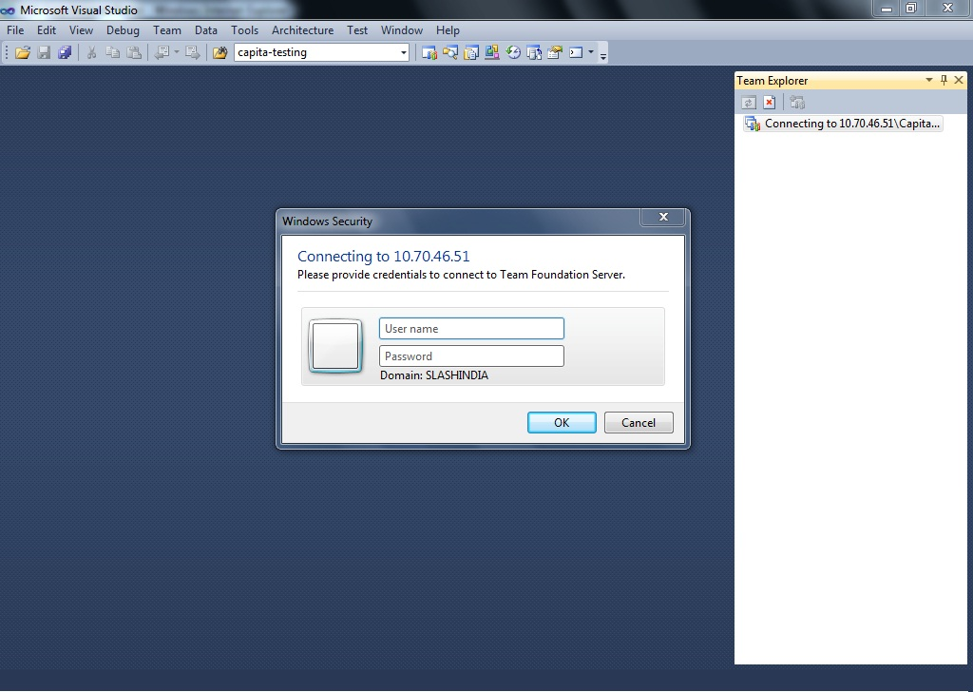
Server Login

Slide 8
Work Items TFS
Bug
Issue
Shared Steps
Task
Test Case
User Story

Slide 9
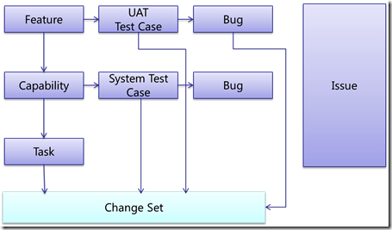
Work Items Relationship

Slide 10
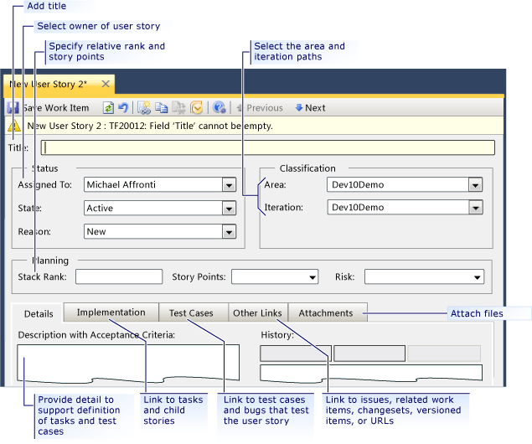
Creating a New User Story

Slide 11
Writing New User Story
In Title (Required), type a short description. It is the functionality that needs to be implemented.
In the Assigned To list, click the name of the team member who owns the user story. If you leave the story unassigned, it is automatically assigned to you.
In the Stack Rank box, type a number that indicates the relative importance of the story compared to the other stories in the product backlog.
    Rank Features and Capabilities by stacking them in rank order (with 1 highest).
    No two Features or Capabilities can have the same rank (very important!)
    Start with Features, then move down to Capabilities
In the Story Points box, type a number that specifies a subjective rating for the amount of work that will be required to complete a user story. If you specify more points, you indicate that more work will be required.
In the Priority list, click the level of importance for the user story on a scale of 1 (most important) to 4 (least important).
In the Area and Iteration lists, click the appropriate area and iteration or leave these fields blank to be assigned later during a planning meeting.

Slide 12
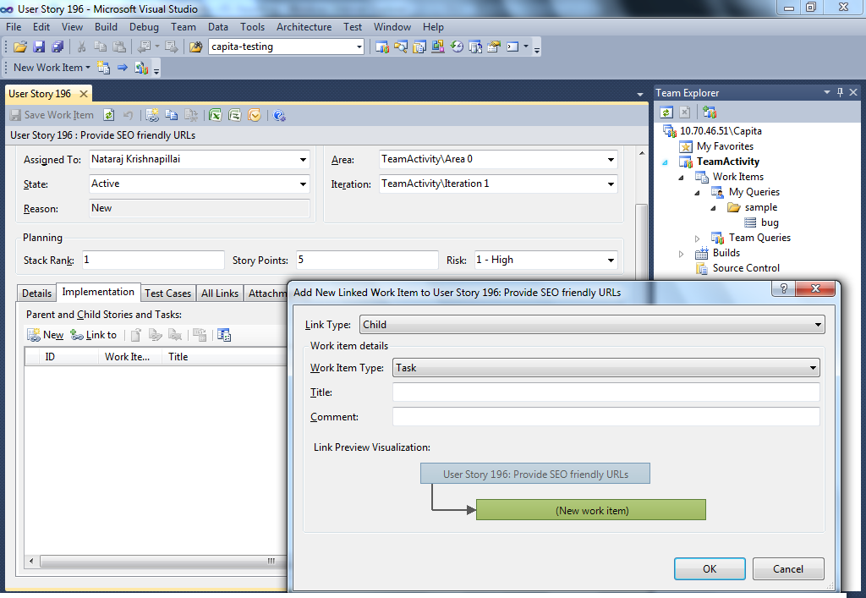
Adding and Linking to a User Story

Slide 13
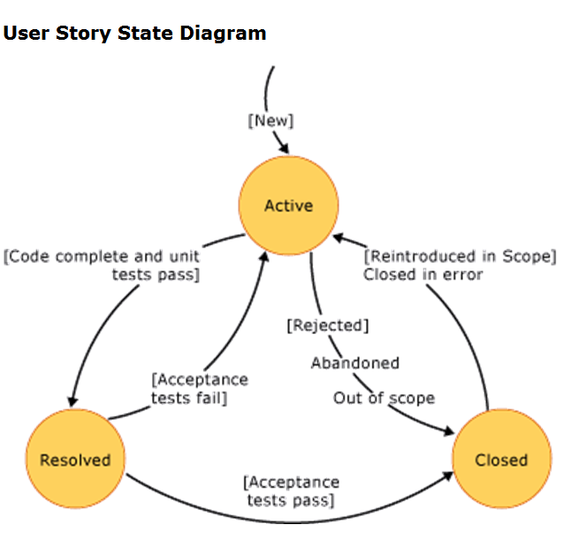
Resolving and Closing a User Story

Slide 14
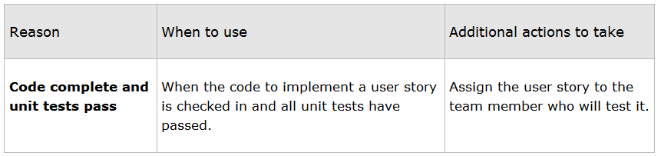
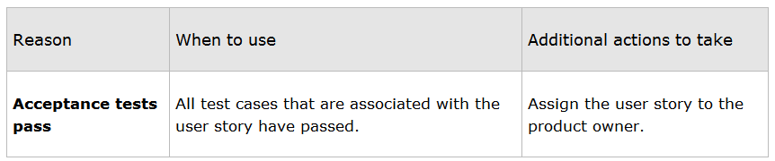
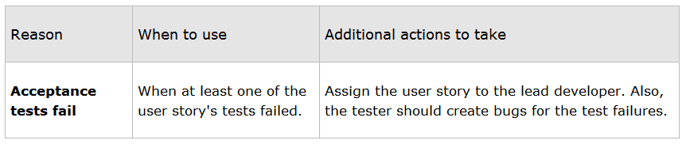
User Story(Active to Resolved State)
User Story(Resolved to Closed State)
User Story(Resolved to Active State)

Slide 15
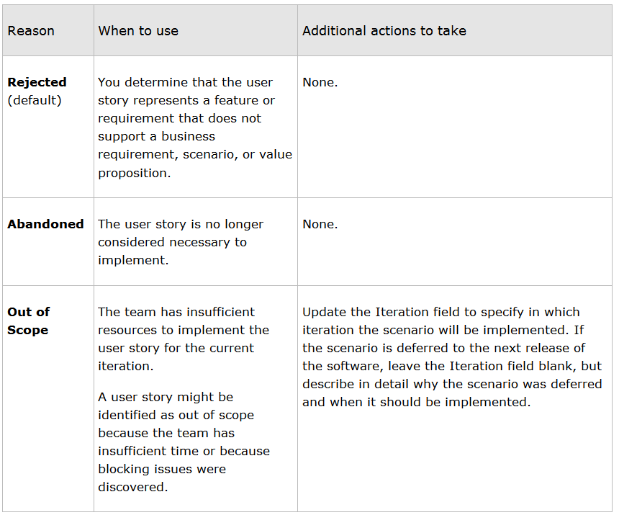
User Story( Active to Closed State)

Slide 16
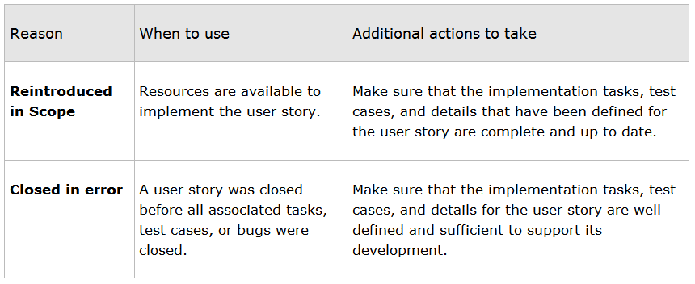
User Story(Closed to Active State)

Slide 17
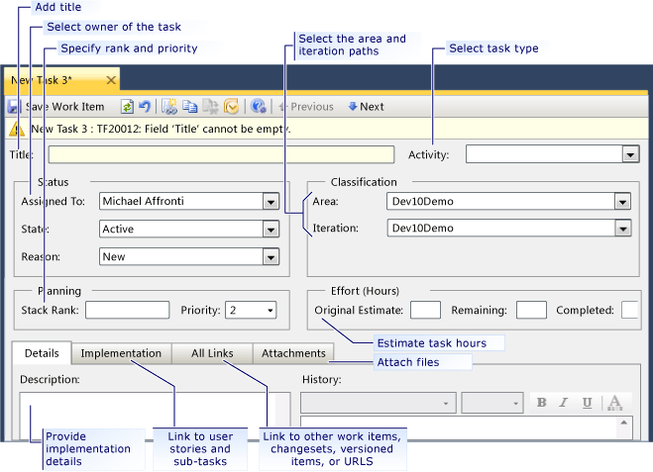
Creating a New Task

Slide 18
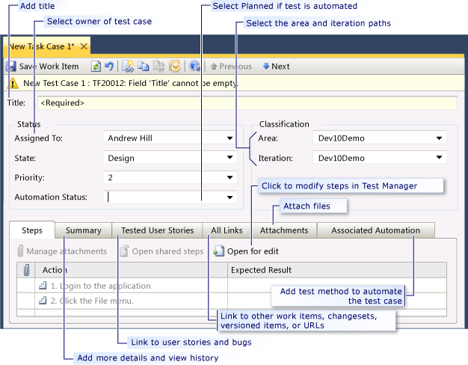
Creating a New Test Case

Slide 19
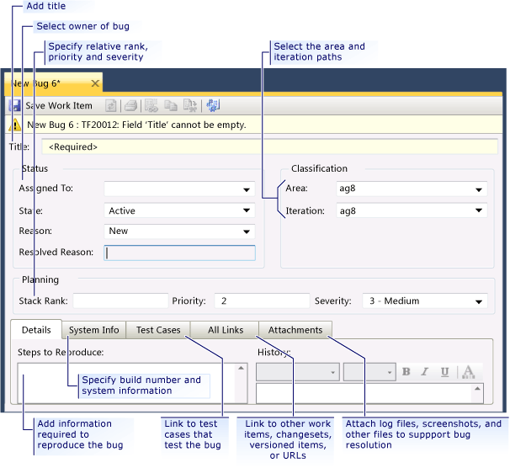
Posting a New Bug

Slide 20
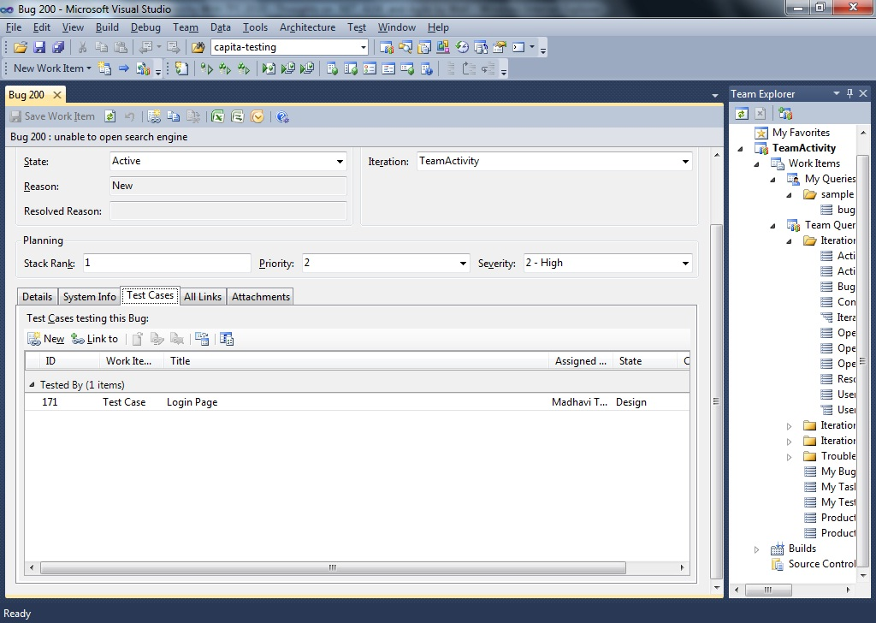
Linking a Test Case to a Bug

Slide 21
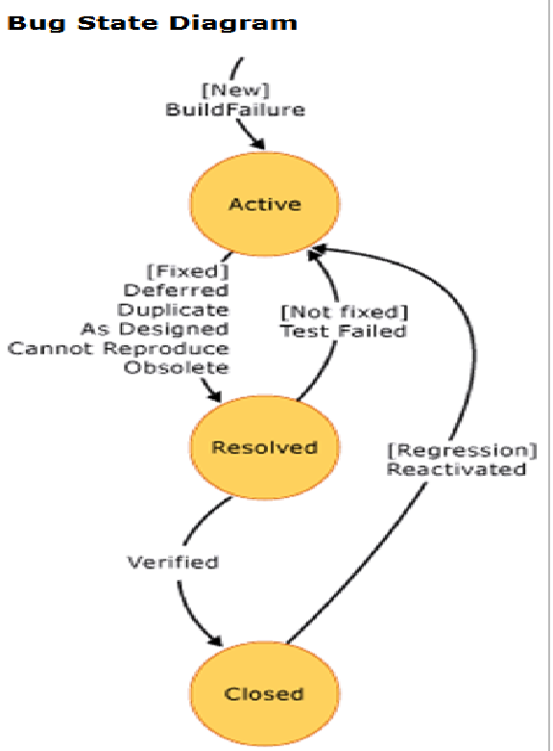
Bug Life Cycle

Slide 22
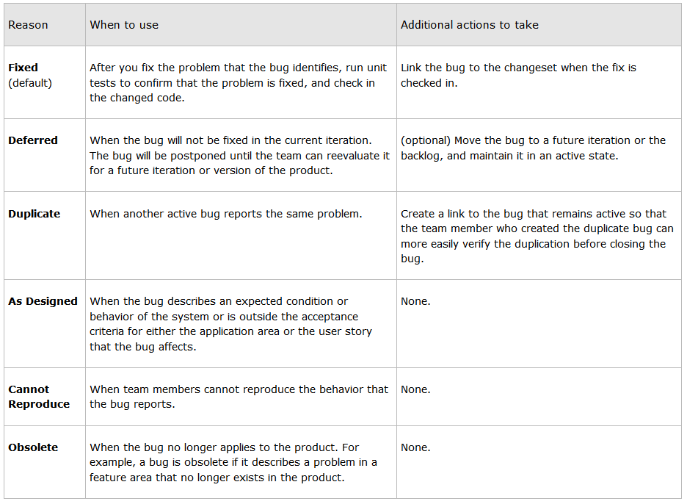
Bug Life Cycle(Active to Resolved State)

Slide 23
Bug Life Cycle(Resolved to Closed State)
The only supported Reason for closing a bug is Verified.

Slide 24
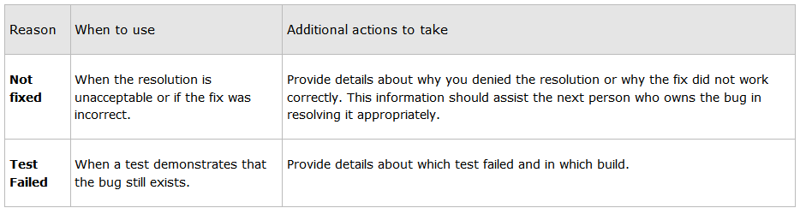
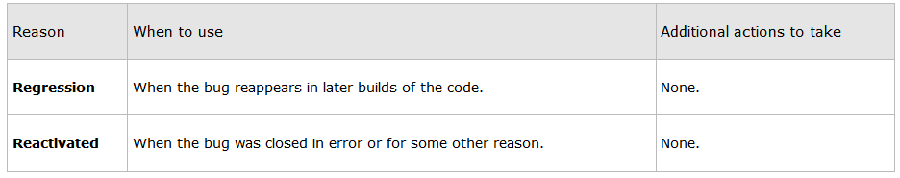
Bug Life Cycle(Resolved to Active State)
Bug Life Cycle(Closed to Active State)

Slide 25
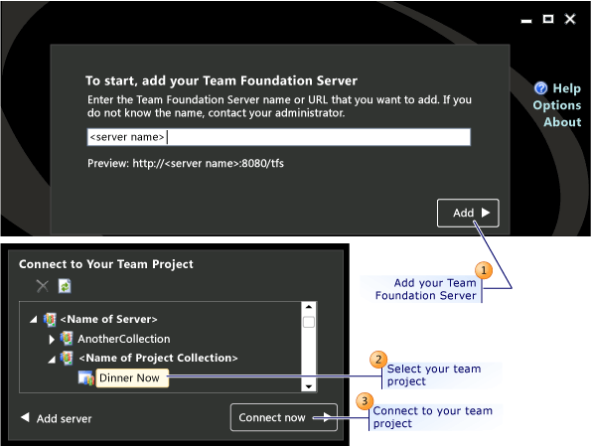
Test Manager

Slide 26
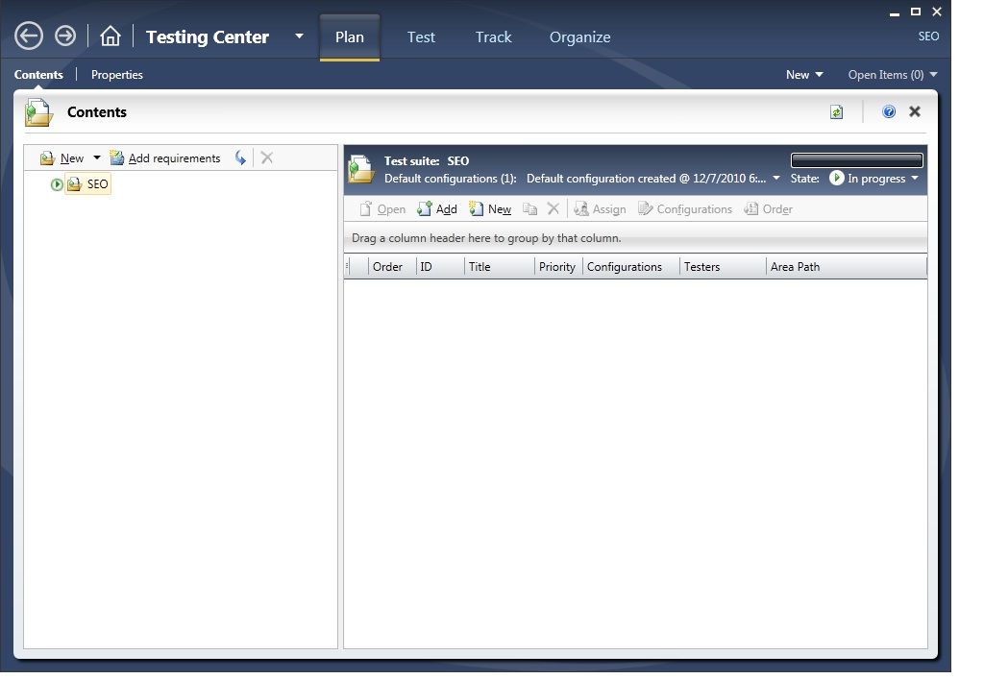
Creating a new Test Plan

Slide 27
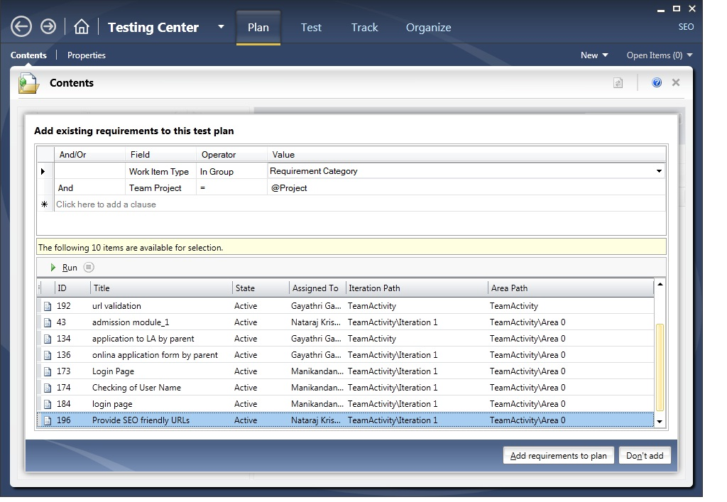
Adding Requirement to Test Plan

Slide 28
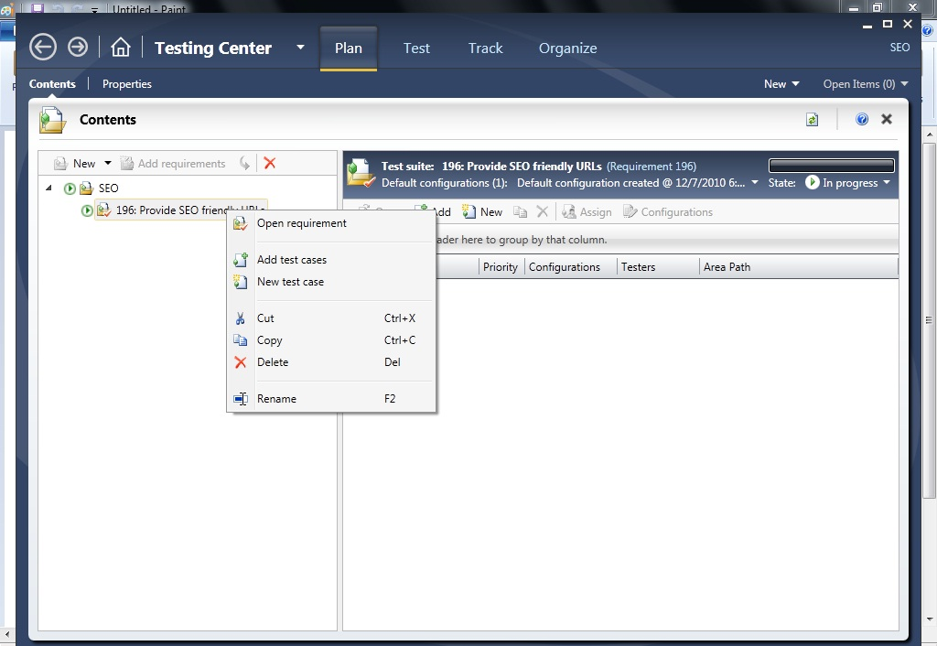
Adding Test Cases to Requirement

Slide 29
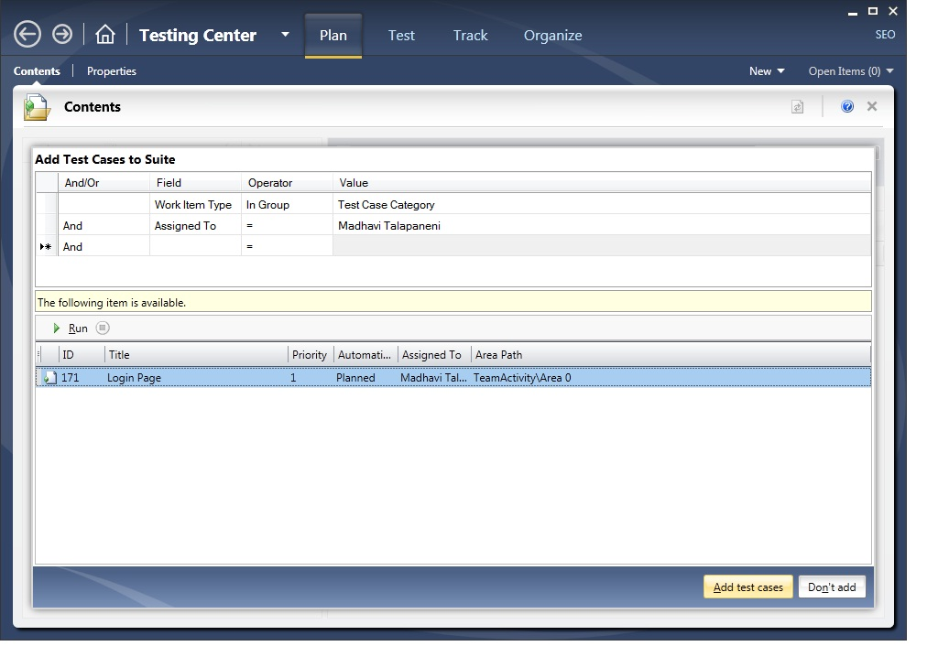
Adding Test Cases to Requirement

Slide 30
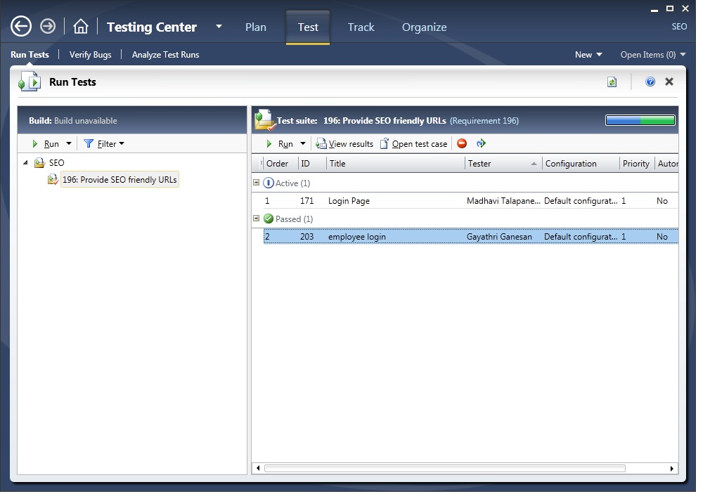
Adding Test Cases to Requirement

Slide 31
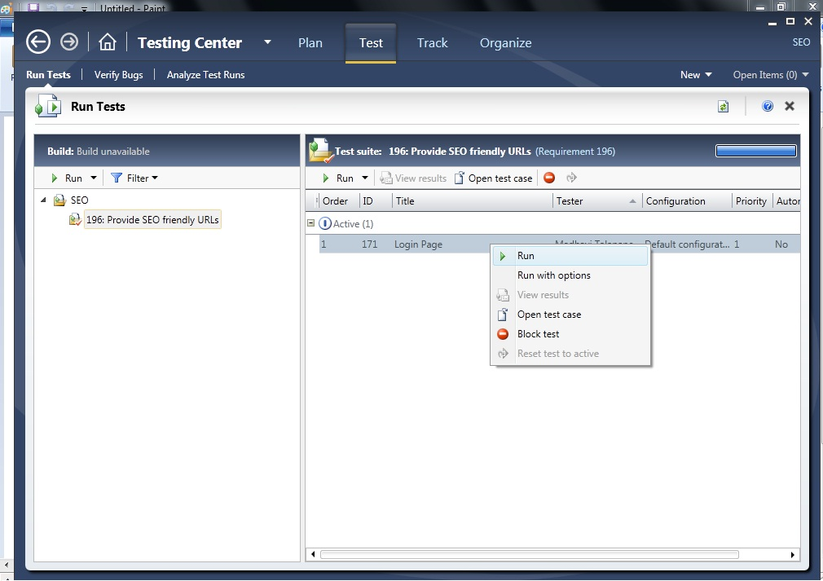
Executing Test Cases

Slide 32
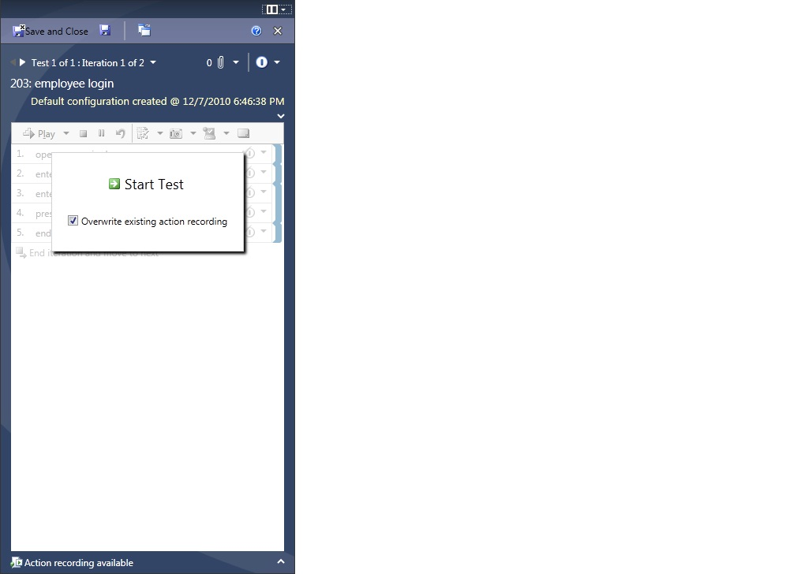
Executing Test Cases

Slide 33
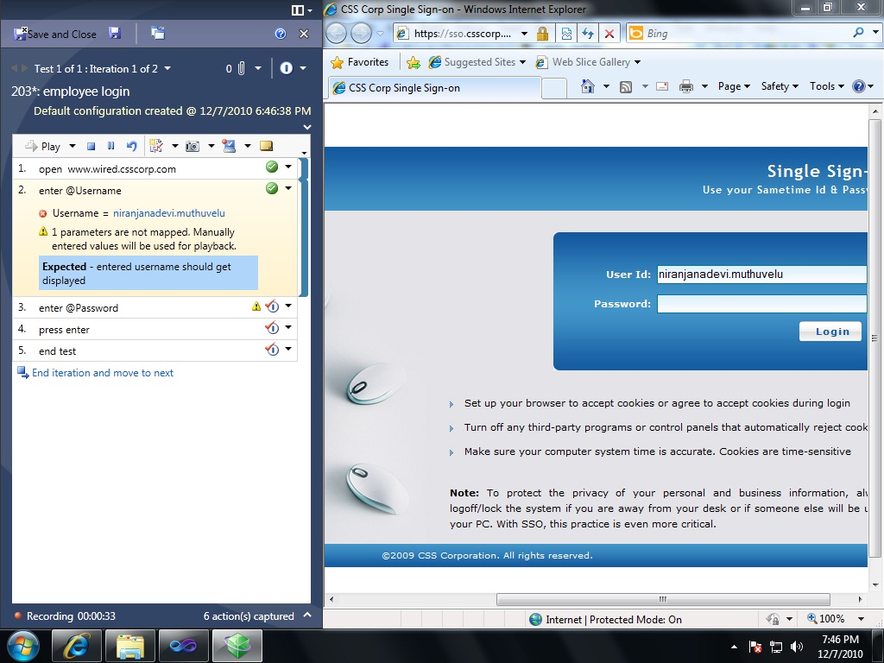
Executing Test Cases

Slide 34
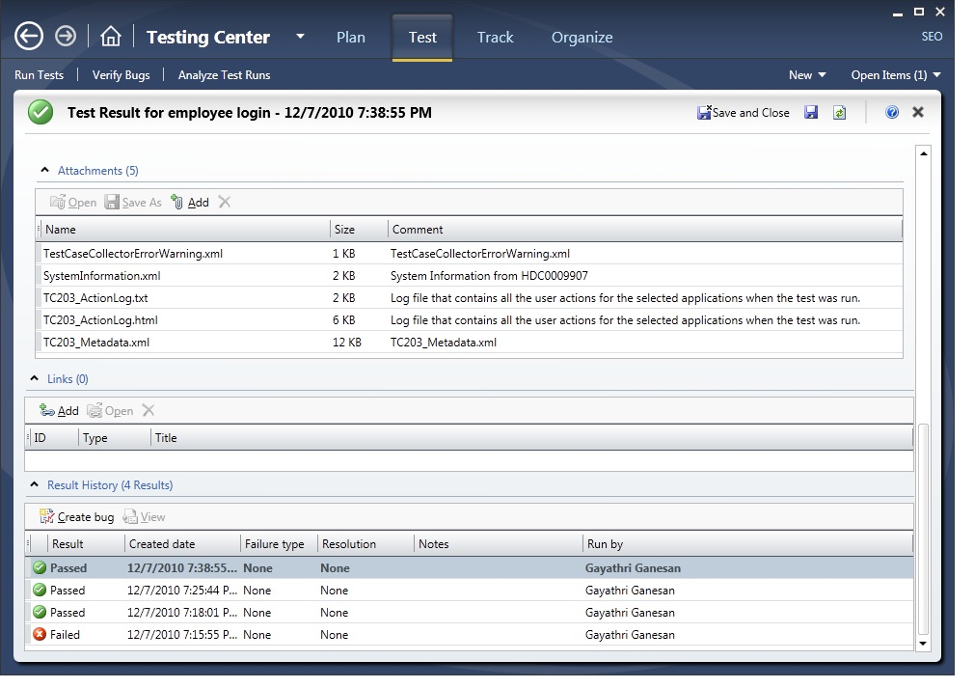
Test Results

Slide 35
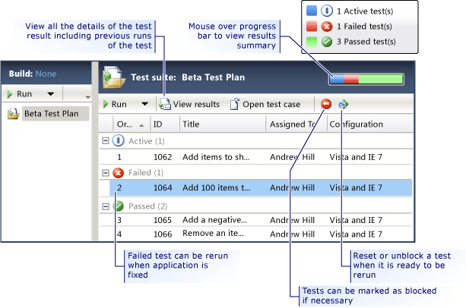
Track Testing Progress

Slide 36
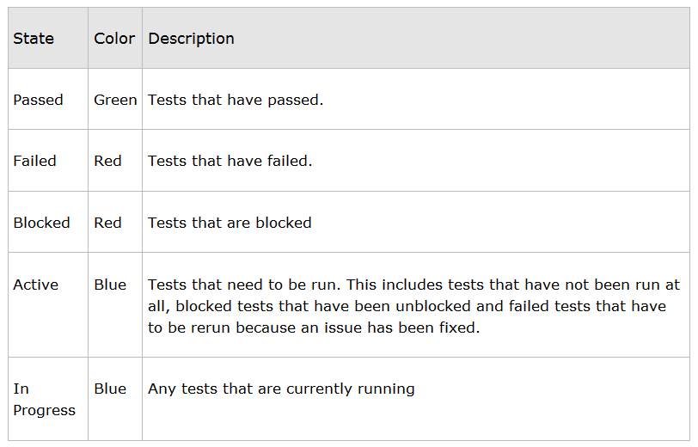
Track Testing Progress

